Slide 1
Melasma

Slide 2
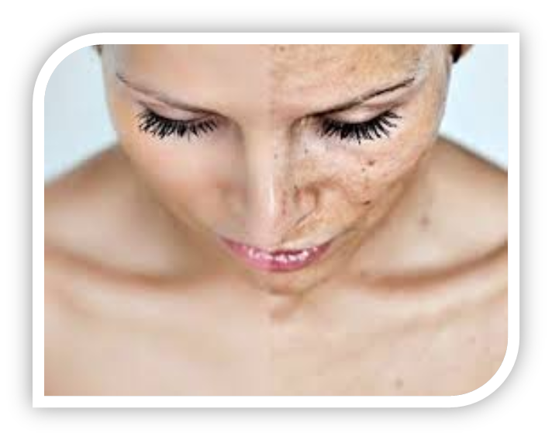
What is Melasma?
Brown patches on the face
Most common in women
(90% of cases)

Slide 3
What Causes Melasma?
Female hormones estrogen and progesterone
Sun exposure
Darker skin

Slide 4
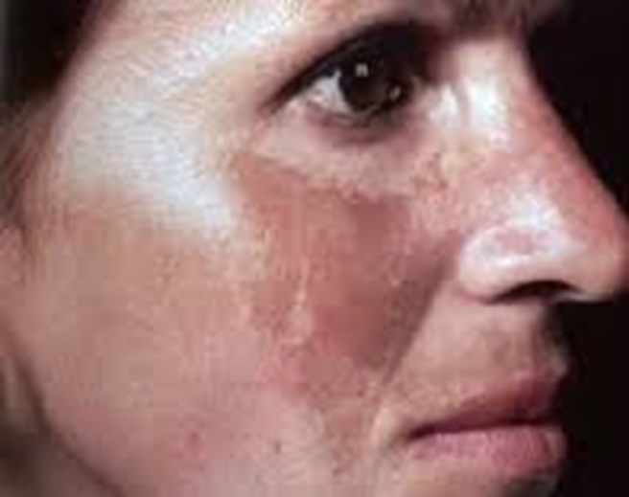
Symptoms of Melasma
Dark patches on the face
Usually symmetrical

Slide 5
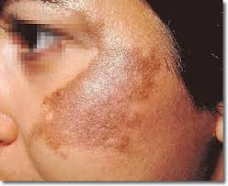
How Long Does It Last?
Can fade over time
Usually lasts your whole life

Slide 6
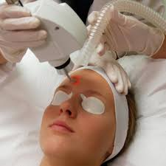
Treatments and costs
Creams
Hydroquinone ($15-$20)
Procedures
Chemical Peels (~$1000)
Laser Treatments (~$2000)
Microdermabrasion ($150)

